Slide 1


A Data-Driven Approach To Bus Timetable Optimisation Recommendations.
Jonathan Foot
MSci Computer Science
psyjpf@nottingham.ac.uk
Notes:
Hello this is Jonathan foot presenting a data driven approach to bus timetable optimisation

Slide 2
Introduction
One of the leading deterrents to bus use is the “belief that buses cannot be relied on to stick to their timetables”.
98% of buses in Great Britain are equipped with Automatic Vehicle Location Devices.
This historical data has been used to drive a search optimisation algorithm based on three criteria.

Slide 3
Optimisation Criteria
1. Minimise the unneeded slack (dwell) time at timing points and the travel times at every stop while balancing the percentage of buses predicted to be “on-time”.
How likely a bus is to meet its scheduled times, given traffic and passenger demand levels.
Keep changes to a minimal to bear resemblance to original timetables.
2. Minimise the total number of changes and the severity of the changes, aiming to keep the timetable as close to the original as possible. Too many changes at once make it difficult to be able to reliably predict how it is likely to function.
Preventing bunches of buses turning up at a stop a specific times of the day. When all services share a route-segment.
3. Maximise the uniform distribution of different services arriving at the same stop, by spreading out headway times. This requires identifying routes that share a common route-segment.

Slide 4

Shared Route-Segment
UTC Reading
City
Centre
Reading College
N or more consecutive stops shared by the primary service and 1 or more services

Slide 5
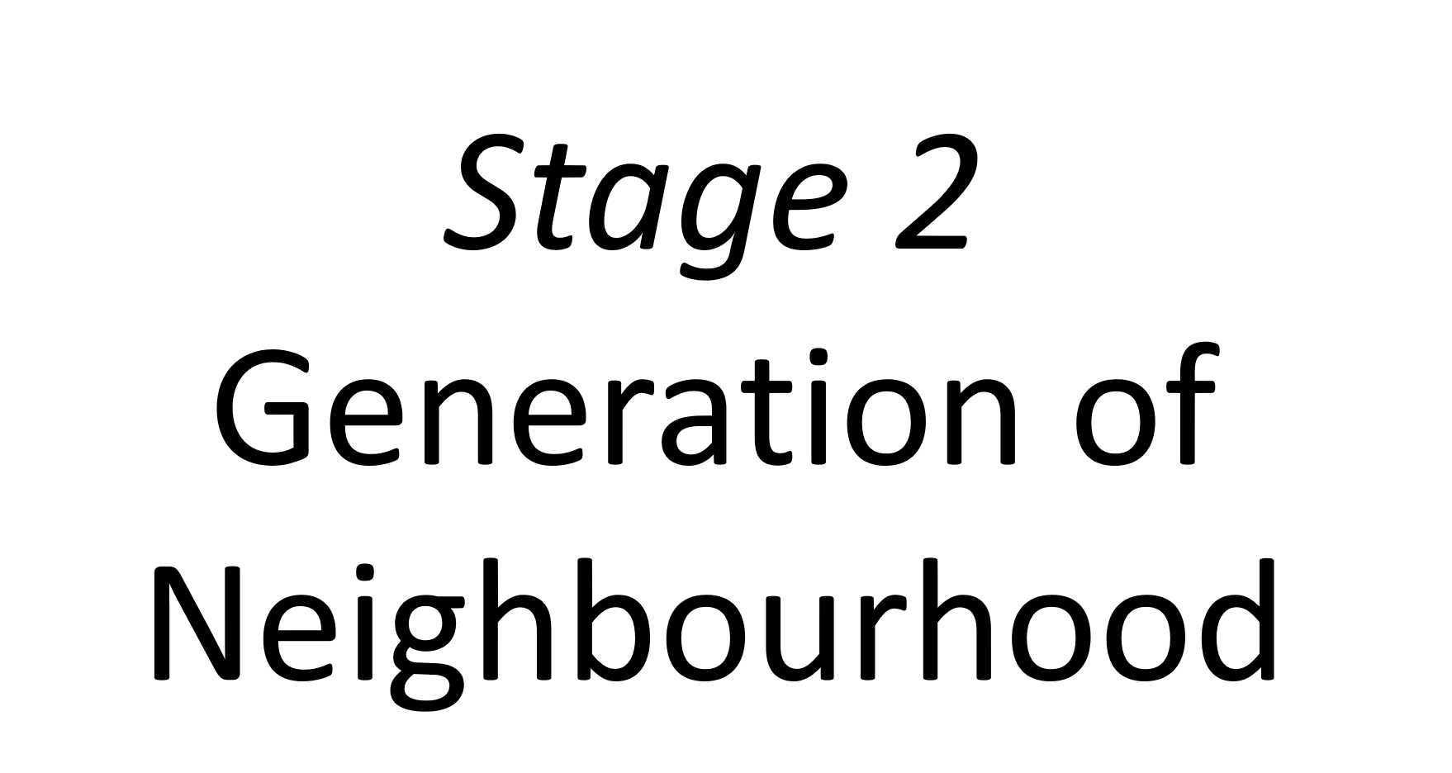
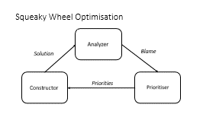
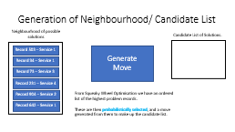
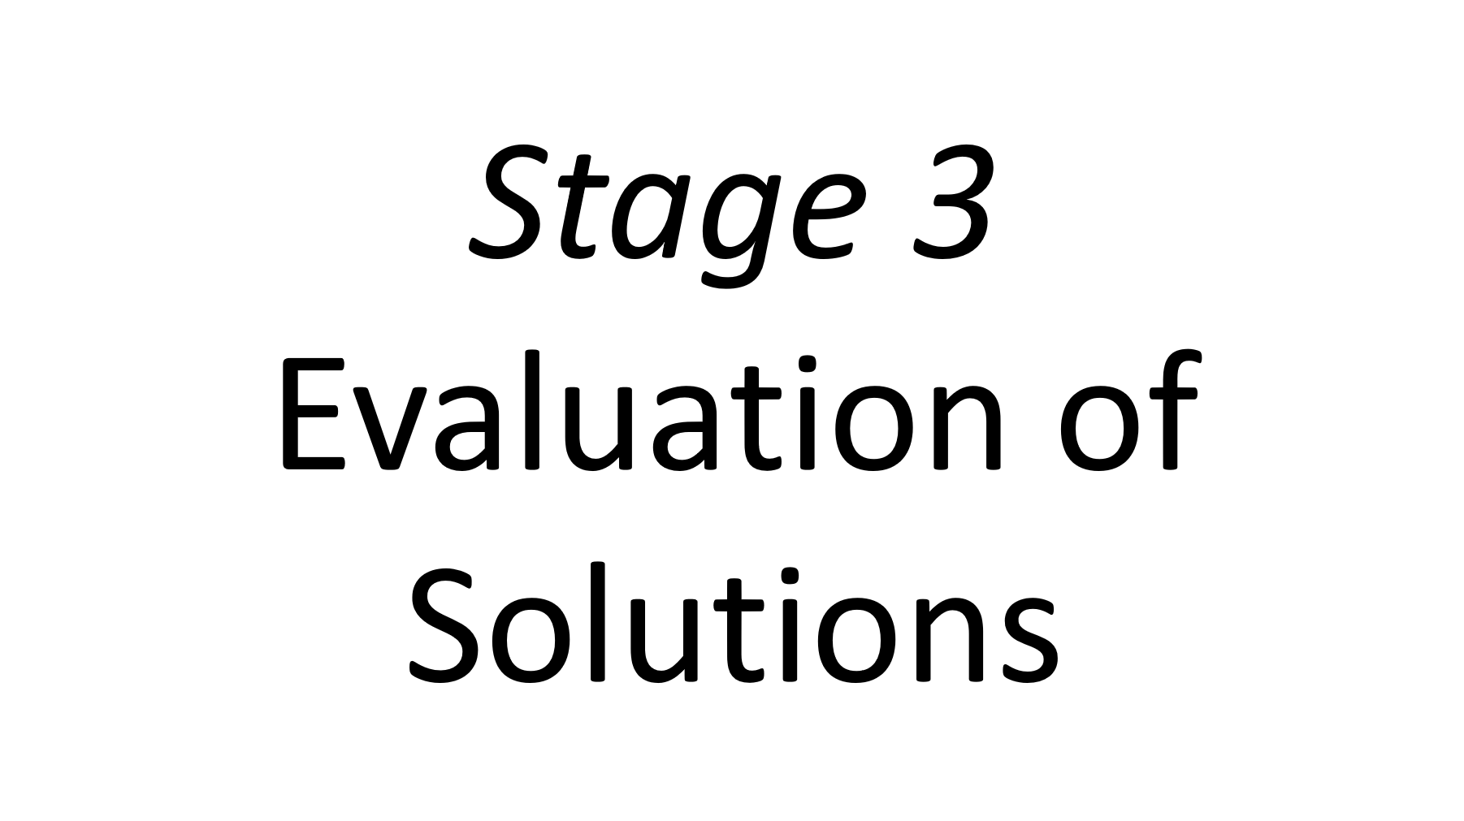
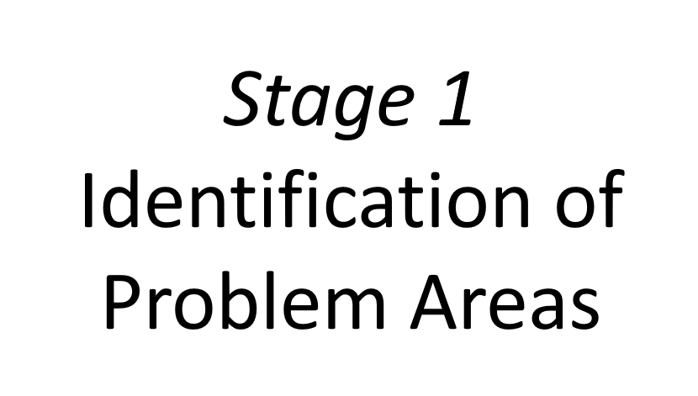
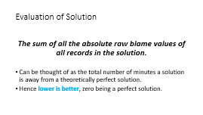
Search Algorithm
Tabu Search
Squeaky Wheel Optimisation

Slide 6
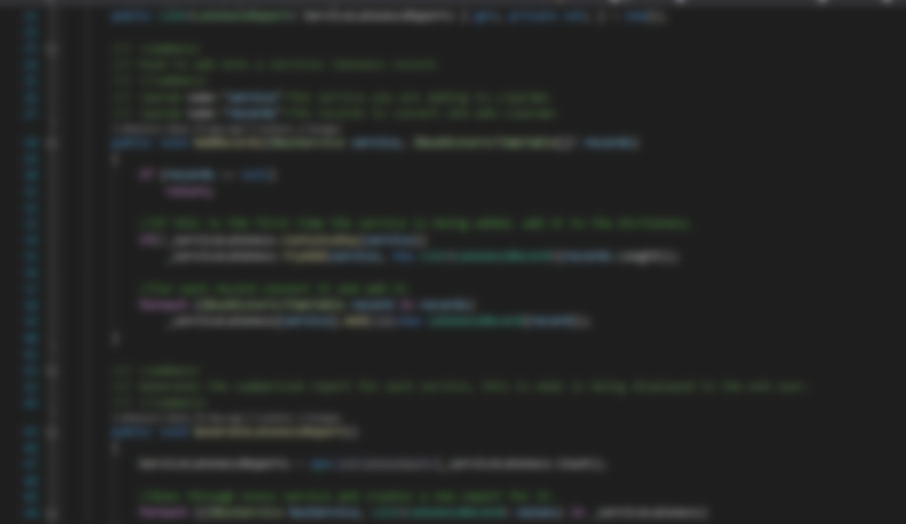
Demo

Slide 7
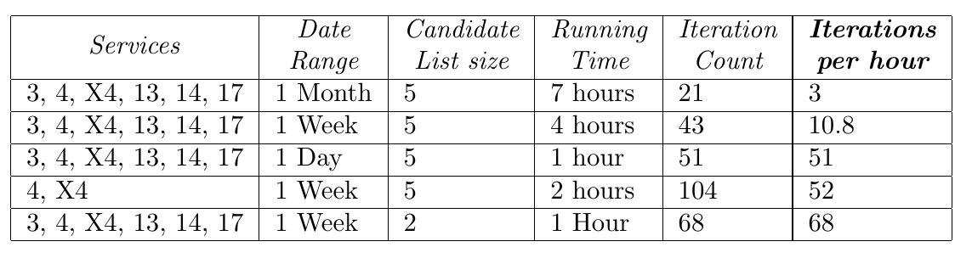
Performance Results

Slide 8
Results

Slide 9
Challenges, Achievements & Conclusion
Difficulties surrounding the large volumes of data – monitoring trends, execution time, program testing and edge cases & erroneous data.
First to use tabu-search for bus timetable optimisation and proved it to be an effective solution.
Exploration of services that share a common route segment.
Can be used by a bus operator to improve their timetables.
Could be used with other bus operators APIs or used with other public transport modes.

Slide 10

Thank you, any questions?

Slide 11

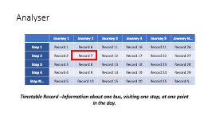
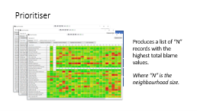
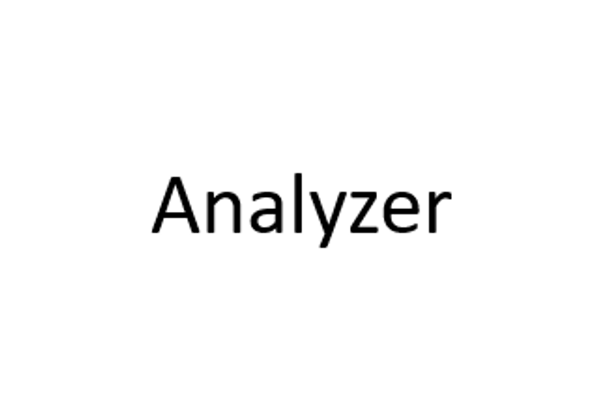
Squeaky Wheel Optimisation
Current Timetables
Solution
Blame
Constructor
Priorities

Slide 12
Squeaky Wheel Optimisation
Current Timetables
Solution
Blame
Constructor
Priorities

Slide 13
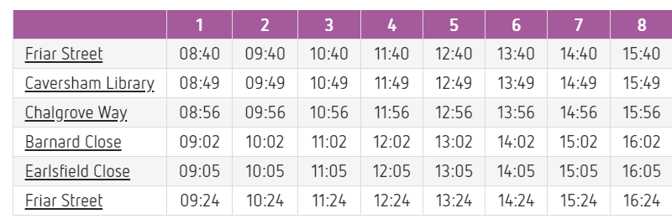
Analyser
 | Journey 1 | Journey 2 | Journey 3 | Journey 4 | Journey 5 | Journey N…
Stop 1 | Record 1 | Record 6 | Record 11 | Record 16 | Record 21 | Record 26
Stop 2 | Record 2 | Record 7 | Record 12 | Record 17 | Record 22 | Record 27
Stop 3 | Record 3 | Record 8 | Record 13 | Record 18 | Record 23 | Record 28
Stop 4 | Record 4 | Record 9 | Record 14 | Record 19 | Record 24 | Record 29
Stop N… | Record 5 | Record 10 | Record 15 | Record 20 | Record 25 | Record N..
Timetable Record –Information about one bus, visiting one stop, at one point in the day.

Slide 14
Timetable Record
Record
Scheduled Arrival Time
Scheduled Departure Time
Blame Values
Total Blame
+
Other info, e.g: Journey ID, Stop ID …
Optimisation Criteria 1 and 3 have their own Objective Functions.
Each Objective Function produces a numerical blame value:
Raw - Number of minutes of difference from current time and desired time.
Normalised – number between 0 to 1
Optimisation Criteria 2 affects solution total blame calculation
Total Blame – Sum of both blame values weighted by dominance.

Slide 15
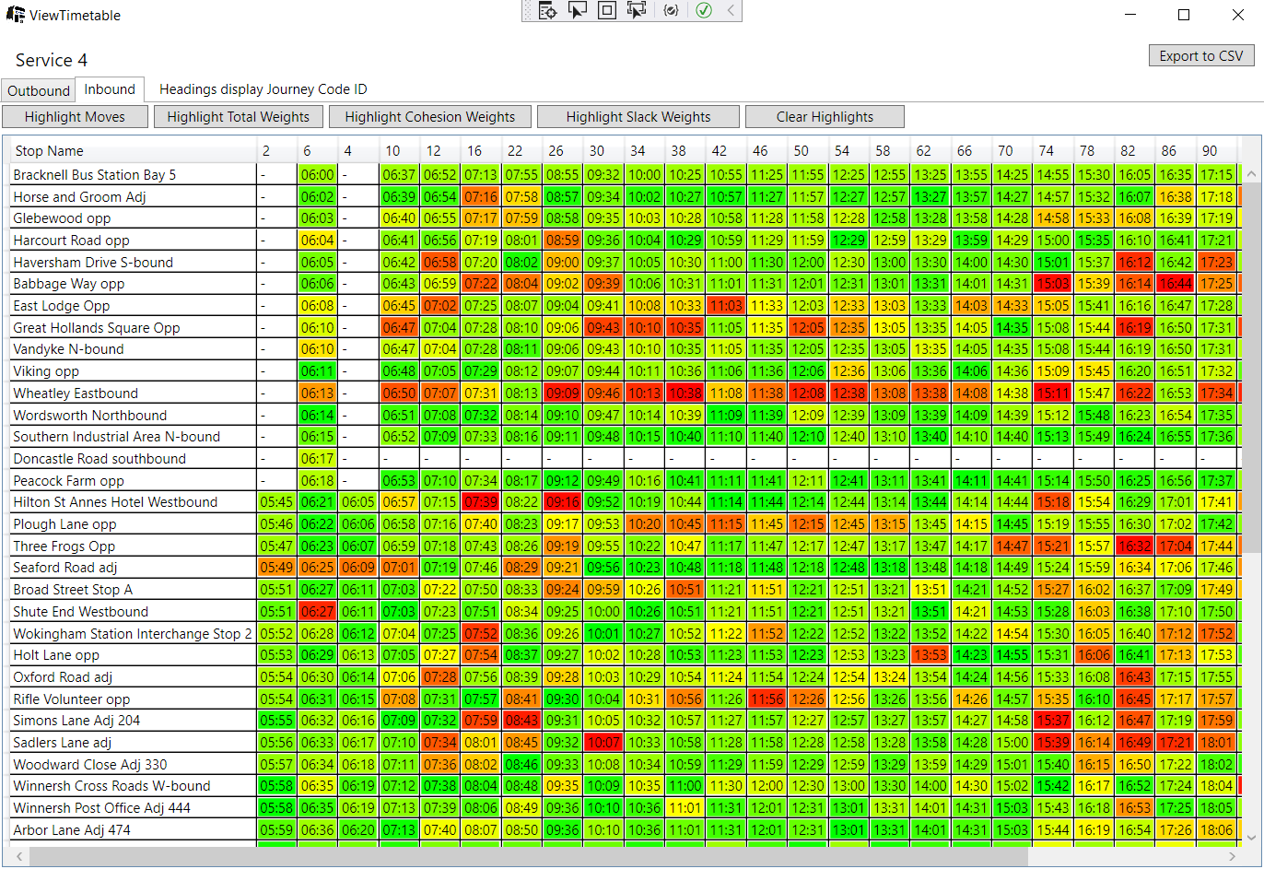

Slide 16
Prioritiser
Record 503 – Service 1
Produces a list of “N” records with the highest total blame values.
Where “N” is the neighbourhood size.
Record 34 – Service 1
Record 73 – Service 3
Record 231 – Service 4
Record 904 – Service 2
Record 642 – Service 1

Slide 17
Generation of Neighbourhood/ Candidate List
Neighbourhood of possible solutions
Candidate List of Solutions.
Record 503 – Service 1
Generate
Move
Move 1 – Service 1
Record 34 – Service 1
Move 2 – Service 4
Record 73 – Service 3
Record 231 – Service 4
Move 3 – Service 2
Record 904 – Service 2
From Squeaky Wheel Optimisation we have an ordered list of the highest problem records.
These are then probabilistically selected, and a move generated from them to make up the candidate list.
Record 642 – Service 1

Slide 18
Move Generation
Record 902 – Service 2
The target record is adjusted to match its desired time.
Move Repair propagates the changes in surrounding records.
Repair “Drop Off” ensures minimal changes.
Moves only ever change one service, rest of solution unchanged.
Record 903 – Service 2
Target Record:
Record 904 – Service 2
Record 905 – Service 2
Record 906 – Service 2
Record 907 – Service 2

Slide 19
Move Repair
Original
8:20
8:24
8:26
8:27
8:31
8:34
8:40
Changed
8:20
8:24
8:30
8:27
8:31
8:34
8:40
Fixed
8:20
8:24
8:30
8:33
8:35
8:37
8:40

Slide 20
Tabu List
Any timetable record that is adjusted is added to the tabu-list.
Regardless of the amount or direction of change; as it’s difficult to distinguish what is perceptually the same timetable.
Timetable records remain tabu for a user-customisable tabu-tenure length.
If a proposed move is attempting to alter tabu-records the move is rejected and a new neighbourhood move is tested.
Prevents getting stuck in local optimums.

Slide 21
Evaluation of Solution
The sum of all the absolute raw blame values of all records in the solution.
Can be thought of as the total number of minutes a solution is away from a theoretically perfect solution.
Hence lower is better, zero being a perfect solution.

Slide 22
Iterating
Best move/solution selected out of the candidate list of solutions.
Cycle repeats, selecting the top N problem areas of the new current solution to build the neighbourhood.
The search algorithm will continue until some threshold iteration count has been achieved.

